Slide 1
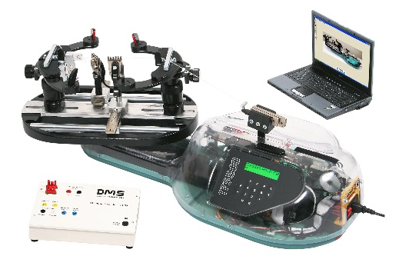
Dossier ressources
ILOT CORDEUSE

Slide 2
ILOT CORDEUSE

